Slide 1

Data Science Capstone Project

Slide 2



Outline
• Executive Summary
• Introduction
• Methodology
• Results
• Conclusion
• Appendix

Slide 3
Overview for Executives
Overview of approaches:
Gathering dataPreparing data
Conducting Exploratory Data Analysis with Data Visualization
Performing Exploratory Data Analysis using SQL
Creating an interactive map with Folium
Developing a Dashboard with Plotly Dash
Predictive analytics (Classification)
Overview of all findings:
Results of Exploratory Data Analysis
Screenshots of the interactive analytics demonstration
Outcomes of the predictive analysis

Slide 4
Introduction
Overview of the project background and context:
SpaceX stands as the leading company in the era of commercial space travel, significantly reducing the costs associated with space exploration. The company promotes its Falcon 9 rocket launches on its website, priced at 62 million dollars, whereas competitors typically charge over 165 million dollars for similar services. This substantial cost reduction largely stems from SpaceX's ability to reuse the first stage of the rocket. Consequently, by assessing whether the first stage will successfully land, we can ascertain the cost implications of a launch. Utilizing publicly available data and machine learning models, we aim to forecast whether SpaceX will be able to reuse the first stage.
Inquiries that require responses:
In what ways do factors like payload mass, launch location, number of flights, and orbits influence the success rate of first stage landings?
Has there been a noticeable increase in the success rate of landings over the years?
Which algorithm is most effective for binary classification in this scenario?

Slide 5
Methodology
Methodology for Data Collection:
Leveraging the SpaceX Rest API
Employing web scraping techniques from Wikipedia
Executed data manipulation.
Data filtering -> Handling missing values -> Implementing One Hot Encoding to prepare the data for binary classification.
Performed exploratory data analysis (EDA) by applying visualization methods and SQL techniques.
Participated in interactive visual analytics using Folium and Plotly Dash.
Carried out predictive analysis through the use of classification models.
Development, fine-tuning, and assessment of classification models to achieve optimal outcomes.

Slide 6
Methodology

Slide 7
Data collection
The data collection process utilized a blend of API requests from the SpaceX REST API and web scraping from a table in SpaceX's Wikipedia page.
Employing both methods was essential to gather comprehensive information regarding the launches, enabling a more thorough analysis.
Data columns are generated through the utilization of the SpaceX REST API:
Flight Number, Date, Booster Version, Payload Mass, Orbit, Launch Site, Outcome, Number of Flights, Grid Fins, Reused Status, Legs, Landing Pad, Block, Reused Count, Serial Number, Longitude, Latitude
Data columns are generated through the process of web scraping from Wikipedia.
Flight Number, Launch Location, Payload, Payload Mass, Orbit, Client, Launch Result, Booster Version, Booster Landing, Date, Time

Slide 8
Data collection – SpaceX API
Requesting data on rocket launches from the SpaceX API
Interpreting the response data with .json() and converting it into a dataframe through .json_normalize()
Inquiring about the necessary details regarding the launches through the SpaceX API by utilizing tailored functions.
Building a dictionary from the data we have collected.
Narrowing the dataframe to exclusively feature Falcon 9 launches.
Filling in the missing values in the Payload Mass column using the calculated mean for that column.
Exporting the data to CSV format

Slide 9
Data collection – Web scraping
Seeking launch data for Falcon 9 from Wikipedia.
Constructing a BeautifulSoup object using the HTML response.
Retrieving all the column names from the header of an HTML table
Gathering data through the parsing of HTML tables.
Organizing the data we have gathered into a dictionary.
Constructing a dataframe from a dictionary
Exporting the data to CSV format

Slide 10
Data wrangling
The data set includes instances where the booster did not land successfully. "True Ocean" denotes a successful landing in the ocean, while "False Ocean" represents a failure in that regard. The terms "True RTLS" and "False RTLS" correspond to successful and unsuccessful ground pad landings, respectively. "True ASDS" indicates a successful landing on a drone ship, whereas "False ASDS" denotes a failed attempt. These results are then transformed into Training Labels, where “1” signifies a successful landing and “0” denotes an unsuccessful one.
Exporting the data to CSV
Conduct exploratory data analysis and establish training labels.
Create a landing outcome label from Outcome column
Calculate the number of launches on each site
Calculate the number and occurrence of mission outcome per orbit type
Calculate the number and occurrence of each orbit

Slide 11
EDA with data visualization
Charts were plotted:
Flight Number vs. Payload Mass, Flight Number vs. Launch Site, Payload Mass vs. Launch Site, Orbit Type vs. Success Rate, Flight Number vs. Orbit Type, Payload Mass vs Orbit Type and Success Rate Yearly Trend
Scatter plots show the relationship between variables. If a relationship exists,
they could be used in machine learning model.
Bar charts show comparisons among discrete categories. The goal is to show the
relationship between the specific categories being compared and a measured
value.
Line charts show trends in data over time (time series).

Slide 12
EDA with SQL
Performed SQL queries:
•Displaying the names of the unique launch sites in the space mission •Displaying 5 records where launch sites begin with the string ‘CCA' •Displaying the total payload mass carried by boosters launched by NASA (CRS) •Displaying average payload mass carried by booster version F9 v1.1 •Listing the date when the first successful landing outcome in ground pad was achieved •Listing the names of the boosters which have success in drone ship and have payload mass greater than 4000 but
less than 6000
•Listing the total number of successful and failure mission outcomes
•Listing the names of the booster versions which have carried the maximum payload mass
•Listing the failed landing outcomes in drone ship, their booster versions and launch site names for the months in
year 2015
•Ranking the count of landing outcomes (such as Failure (drone ship) or Success (ground pad)) between the date
2010-06-04 and 2017-03-20 in descending order

Slide 13
Build an interactive map with Folium
Markers of all Launch Sites:
- Added Marker with Circle, Popup Label and Text Label of NASA Johnson Space Center using its latitude and longitude coordinates as a start location.
- Added Markers with Circle, Popup Label and Text Label of all Launch Sites using their latitude
and longitude coordinates to show their geographical locations and proximity to Equator and
coasts.
Coloured Markers of the launch outcomes for each Launch Site:
- Added coloured Markers of success (Green) and failed (Red) launches using Marker Cluster to identify which launch sites have relatively high success rates.
Distances between a Launch Site to its proximities:
- Added coloured Lines to show distances between the Launch Site KSC LC-39A (as an example) and its proximities like Railway, Highway, Coastline and Closest City.

Slide 14
Build a Dashboard with Plotly Dash
Launch Sites Dropdown List:
- Added a dropdown list to enable Launch Site selection.
Pie Chart showing Success Launches (All Sites/Certain Site):
- Added a pie chart to show the total successful launches count for all sites and the Success vs. Failed counts for the site, if a specific Launch Site was selected.
Slider of Payload Mass Range:
- Added a slider to select Payload range.
Scatter Chart of Payload Mass vs. Success Rate for the diﬀerent Booster Versions:
- Added a scatter chart to show the correlation between Payload and Launch Success.
GitHub URL: SpaceX Dash App

Slide 15
Predictive analysis (Classification)
Standardizing the data with StandardScaler, then fitting and
Splitting the data into training and testing sets with train_test_split
Creating a GridSearchCV object with cv = 10 to find
Creating a NumPy array from the column
“Class” in data
the best parameters
transforming it
function
Finding the method performs best by examining the Jaccard_score and
Calculating the accuracy on the test data using the method .score()
Applying GridSearchCV on LogReg, SVM, Decision Tree, and
Examining the confusion matrix
for all models
F1_score metrics
for all models
KNN models

Slide 16


Results
• Exploratory data analysis results • Interactive analytics demo in
screenshots
•Predictive analysis results

Slide 17
EDA with Visualization

Slide 18
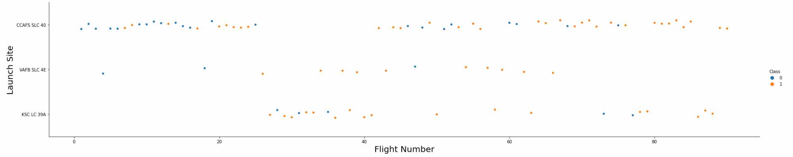
Flight Number vs. Launch Site
Explanation:
•The earliest flights all failed while the latest flights all succeeded. •The CCAFS SLC 40 launch site has about a half of all launches. •VAFB SLC 4E and KSC LC 39A have higher success rates. •It can be assumed that each new launch has a higher rate of success.

Slide 19
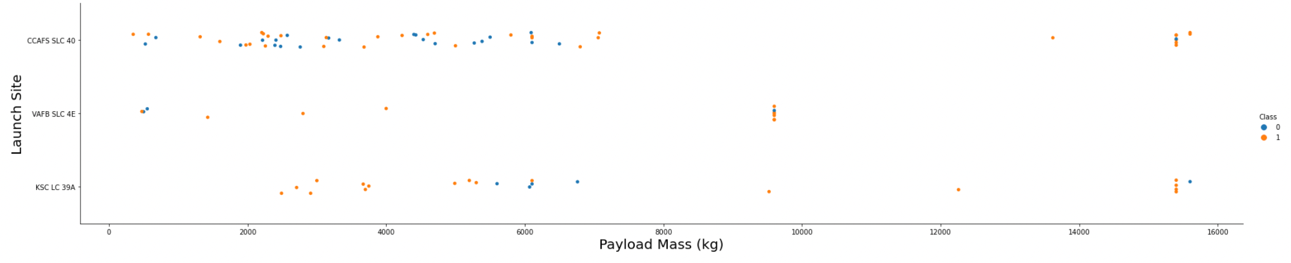
Payload vs. Launch Site
Explanation:
•For every launch site the higher the payload mass, the higher the success
rate.
•Most of the launches with payload mass over 7000 kg were successful.
•KSC LC 39A has a 100% success rate for payload mass under 5500 kg too.

Slide 20
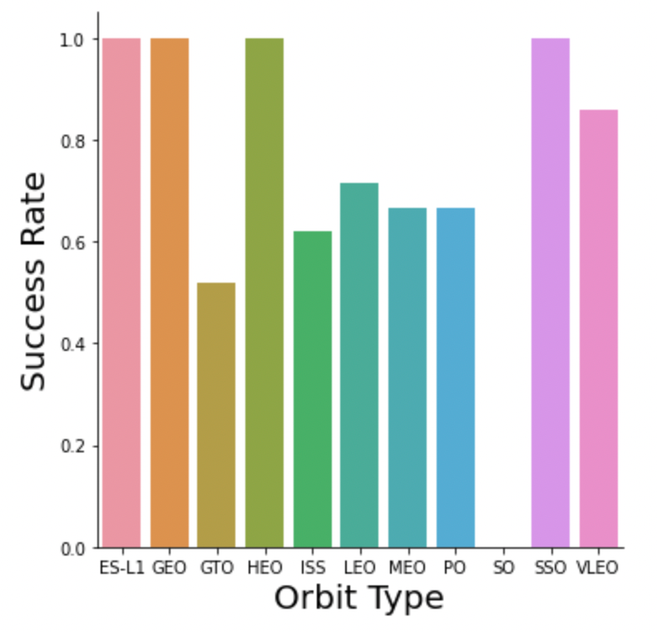
Success rate vs. Orbit type
Explanation:
•Orbits with 100% success rate:
-ES-L1, GEO, HEO, SSO
•Orbits with 0% success rate:
-SO
•Orbits with success rate
between 50% and 85%:
-GTO, ISS, LEO, MEO, PO

Slide 21
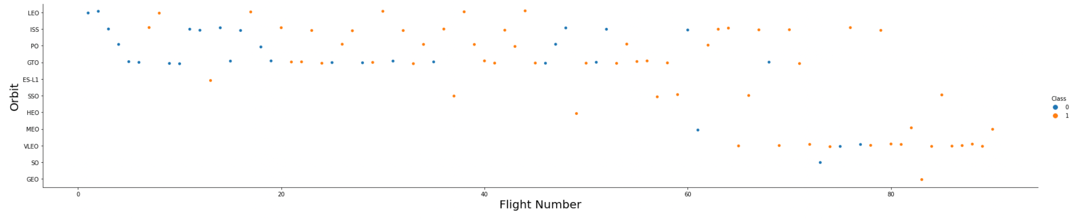
Flight Number vs. Orbit type
Explanation:
•In the LEO orbit the Success appears related to the number of flights; on the other hand, there seems to be no relationship between flight number when in GTO orbit.

Slide 22
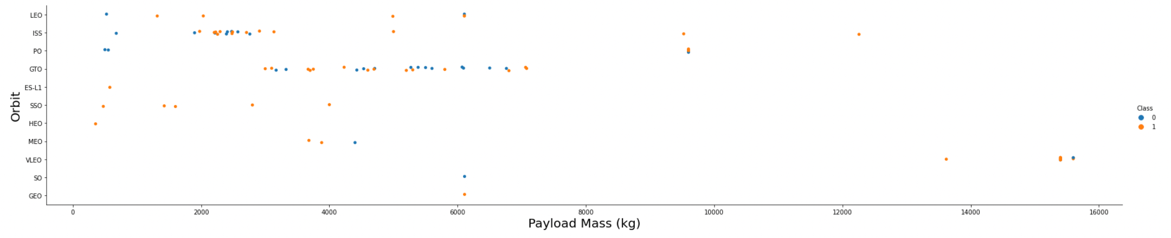
Payload Mass vs. Orbit type
Explanation:
•Heavy payloads have a negative influence on GTO orbits and positive
on GTO and Polar LEO (ISS) orbits.

Slide 23
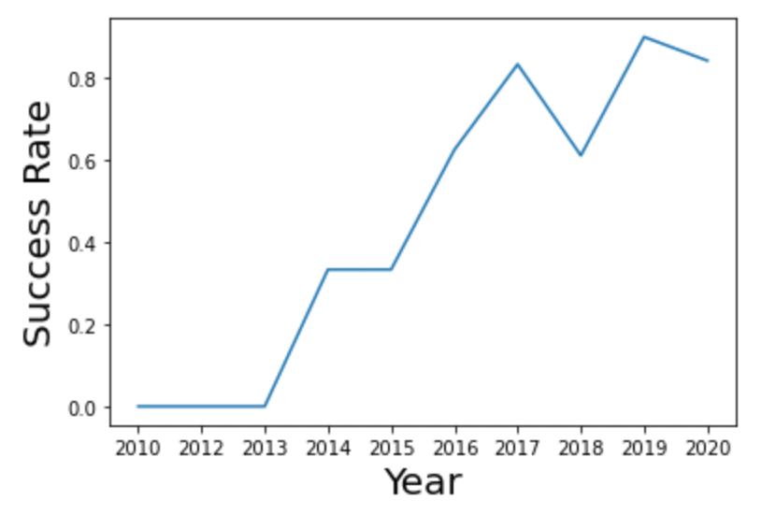
Launch success yearly trend
Explanation:
•The success rate
since 2013 kept increasing till 2020.

Slide 24
EDA with SQL

Slide 25
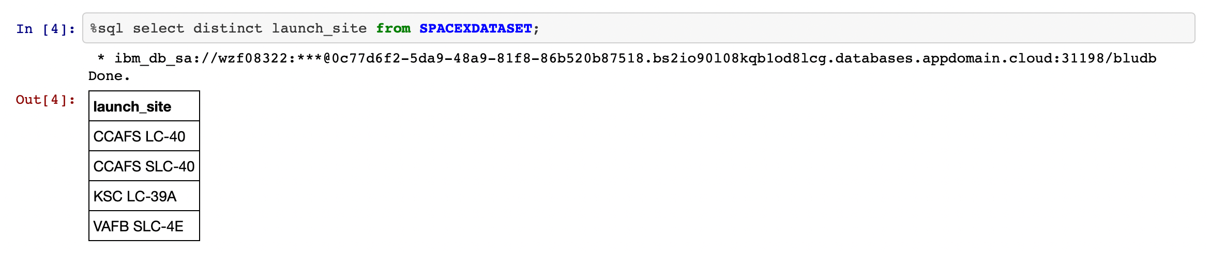
All launch site names
Explanation:
•Displaying the names of the unique launch sites in the space mission.

Slide 26
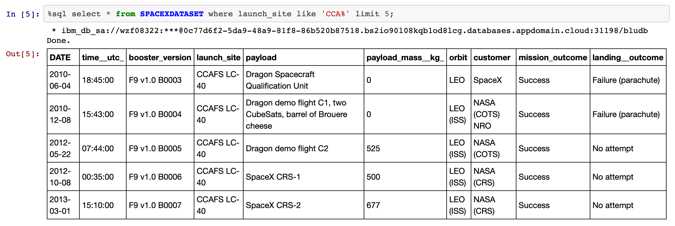
Launch site names begin with `CCA`
Explanation:
•Displaying 5 records where launch sites begin with the string 'CCA'.

Slide 27
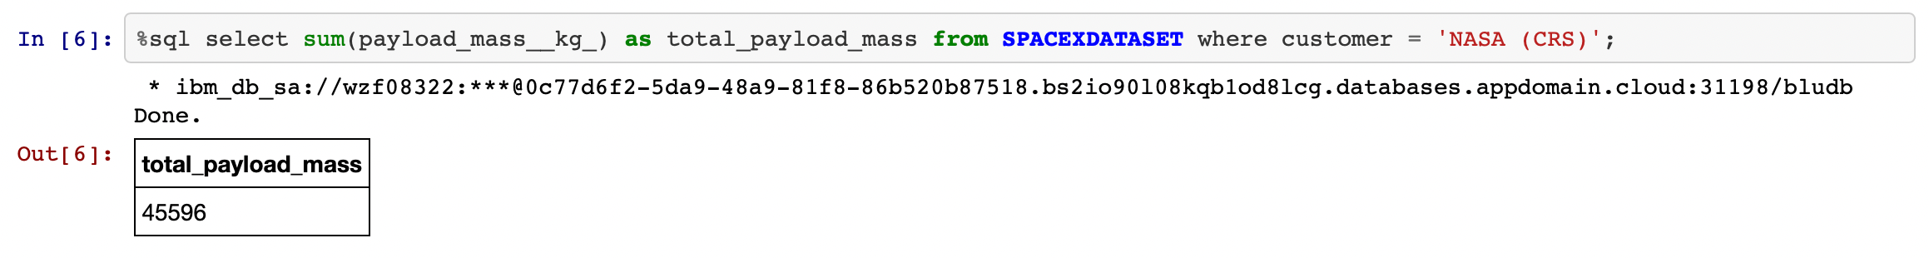
Total payload mass
Explanation:
•Displaying the total payload mass carried by boosters launched by
NASA (CRS).

Slide 28
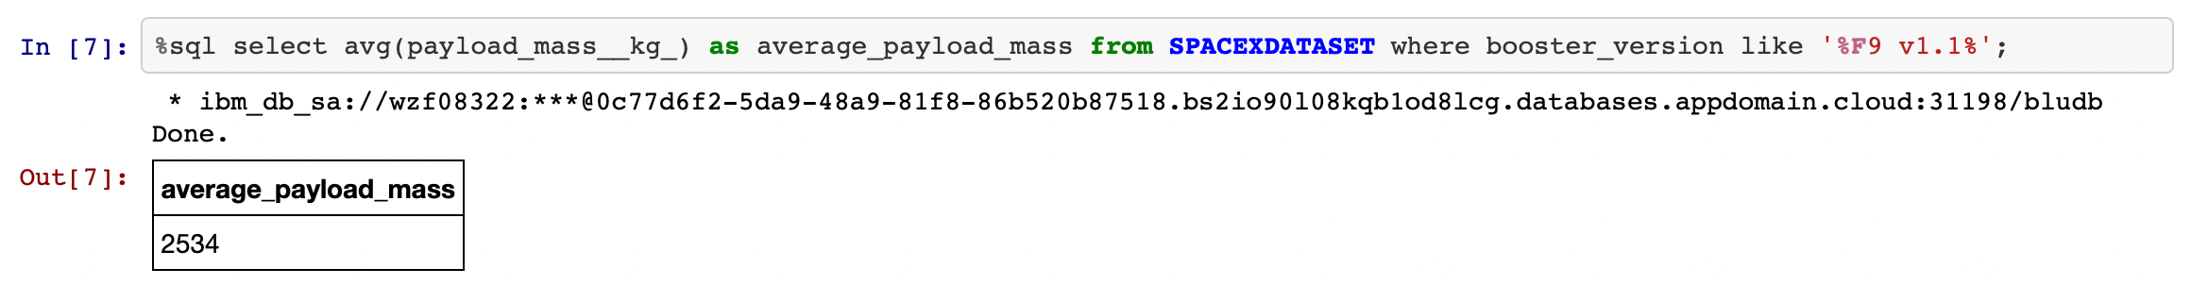
Average payload mass by F9 v1.1
Explanation:
•Displaying average payload mass carried by booster version F9 v1.1.

Slide 29
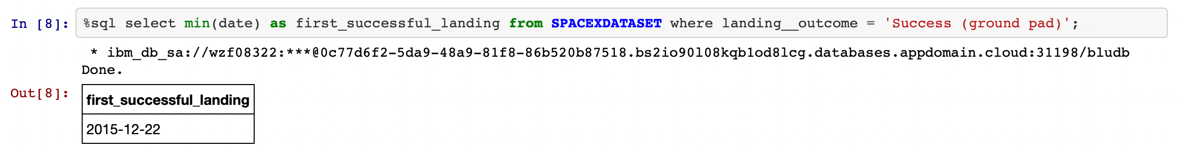
First successful ground landing date
Explanation:
•Listing the date when the first successful landing outcome in ground
pad was achieved.

Slide 30
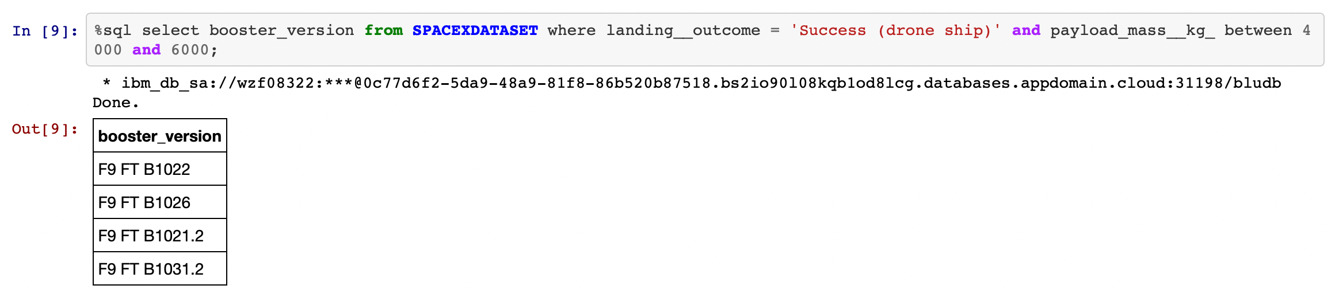
Successful drone ship landing with payload
between 4000 and 6000
Explanation:
•Listing the names of the boosters which have success in drone ship
and have payload mass greater than 4000 but less than 6000.

Slide 31
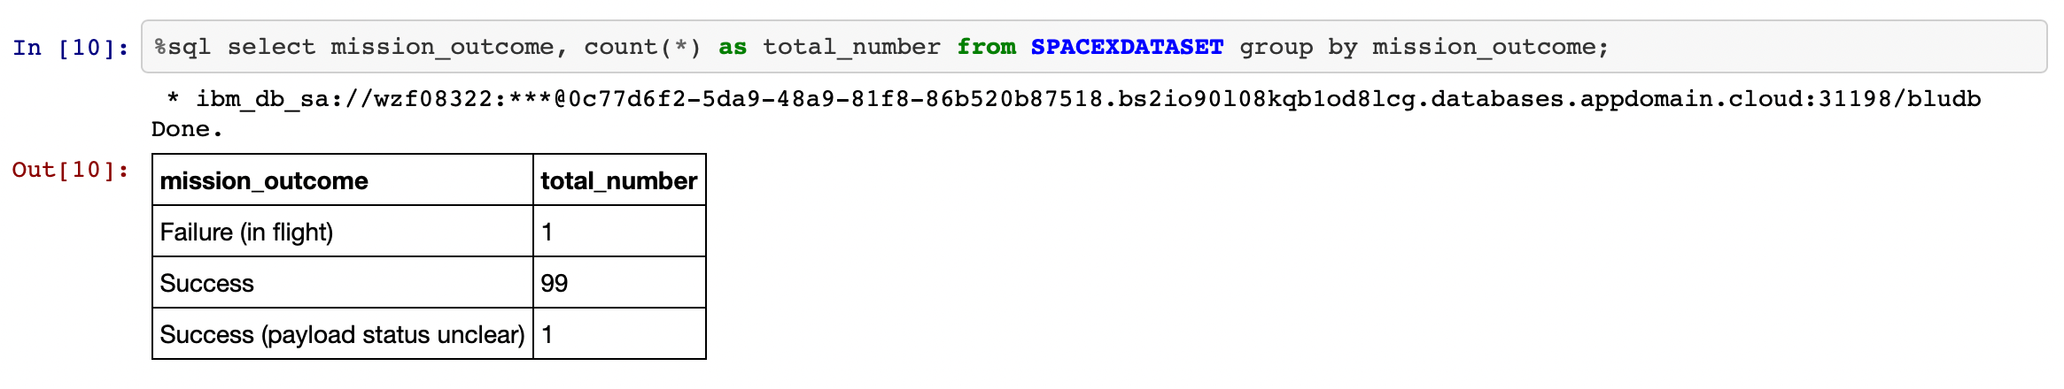
Total number of successful and failure mission outcomes
Explanation:
•Listing the total number of successful and failure mission outcomes.

Slide 32
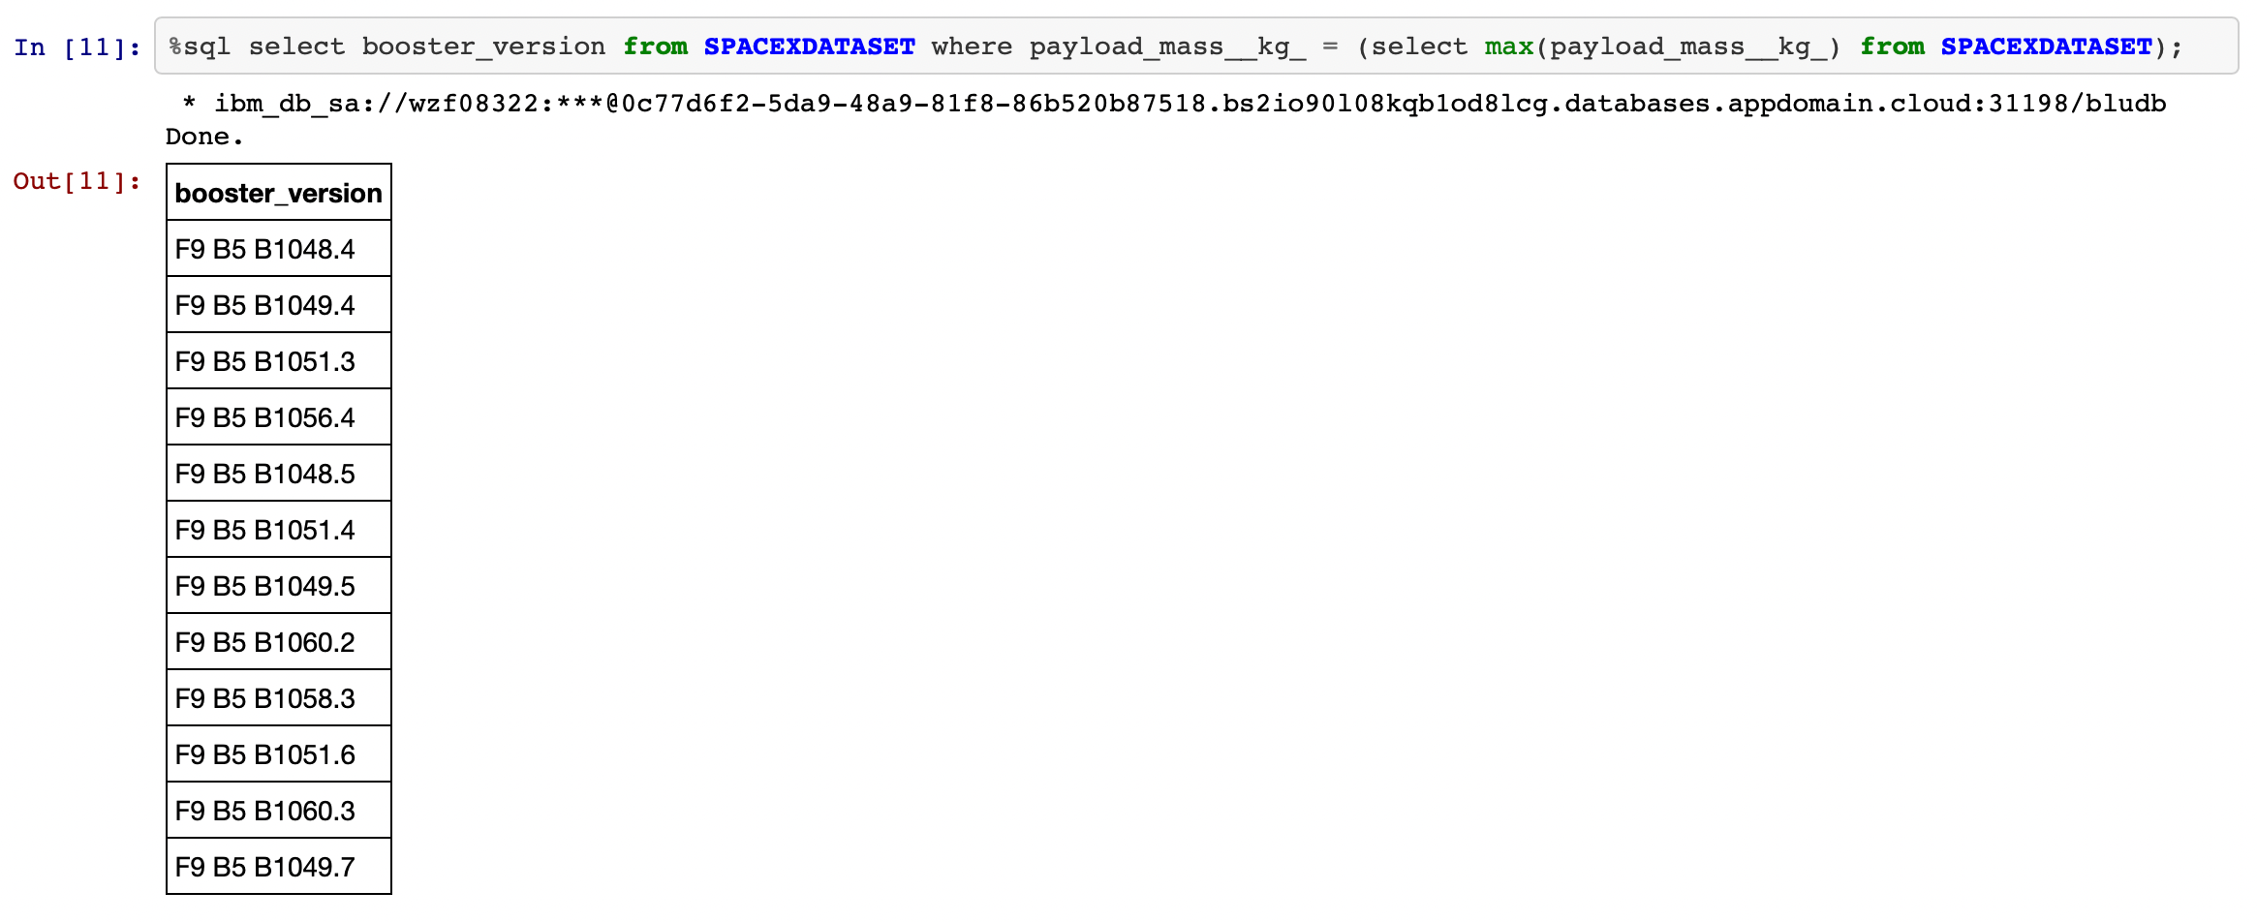
Boosters carried maximum payload
Explanation:
•Listing the names of the booster versions which have carried the maximum
payload mass.

Slide 33
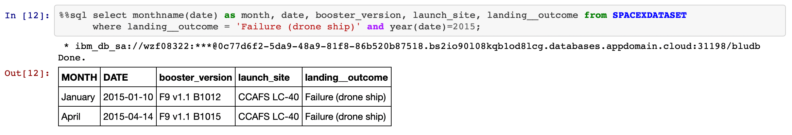
2015 launch records
Explanation:
•Listing the failed landing outcomes in drone ship, their booster
versions and launch site names for the months in year 2015.

Slide 34
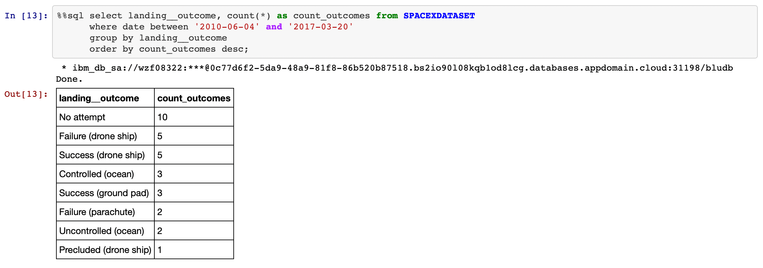
Rank success count between 2010-06-04 and 2017-03-20
Explanation:
•Ranking the count of landing outcomes (such as Failure (drone ship) or Success
(ground pad)) between the date 2010-06-04 and 2017-03-20 in descending order.

Slide 35
Interactive map with Folium

Slide 36
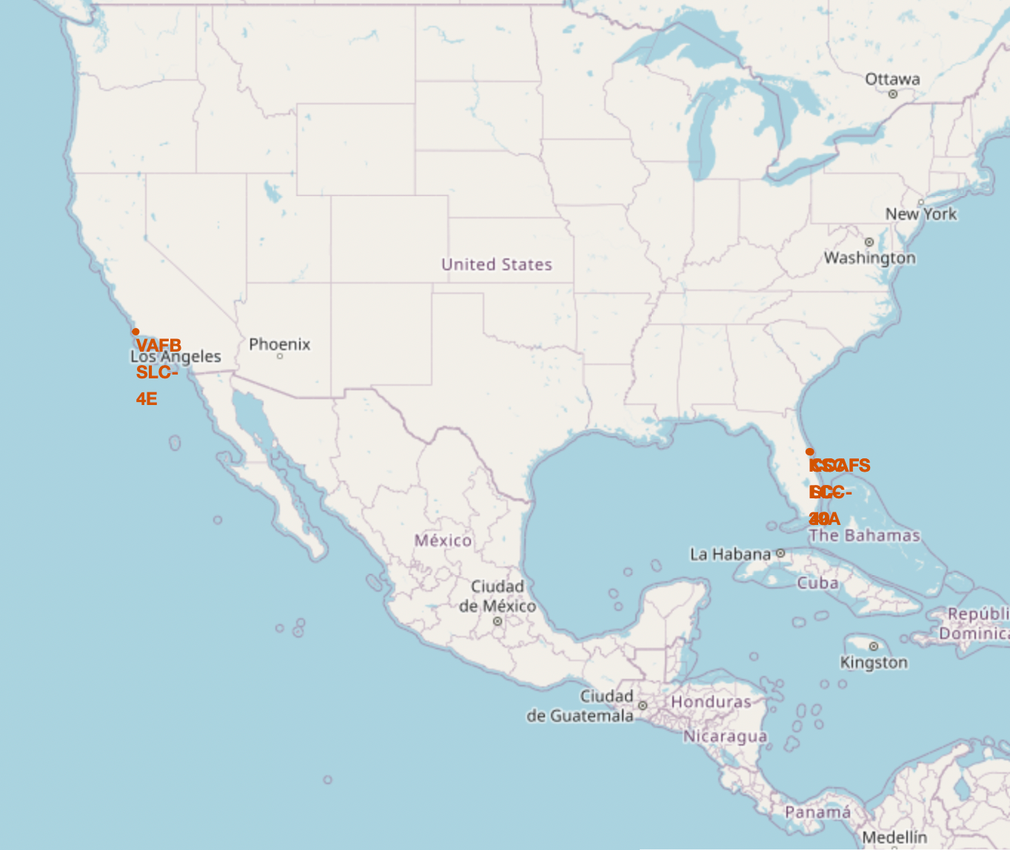
All launch location markers on a map
Explanation:
•Most of Launch sites are in proximity to the
Equator line. The land is moving faster at the equator than any other place on the surface of the Earth. Anything on the surface of the Earth at the equator is already moving at 1670 km/hour. If a ship is launched from the equator it goes up into space, and it is also moving around the Earth at the same speed it was moving before launching. This is because of inertia. This speed will help the spacecraft keep up a good enough speed to stay in orbit.
•All launch sites are in very close proximity
to the coast, while launching rockets
towards the ocean it minimises the risk of
having any debris dropping or exploding
near people.

Slide 37
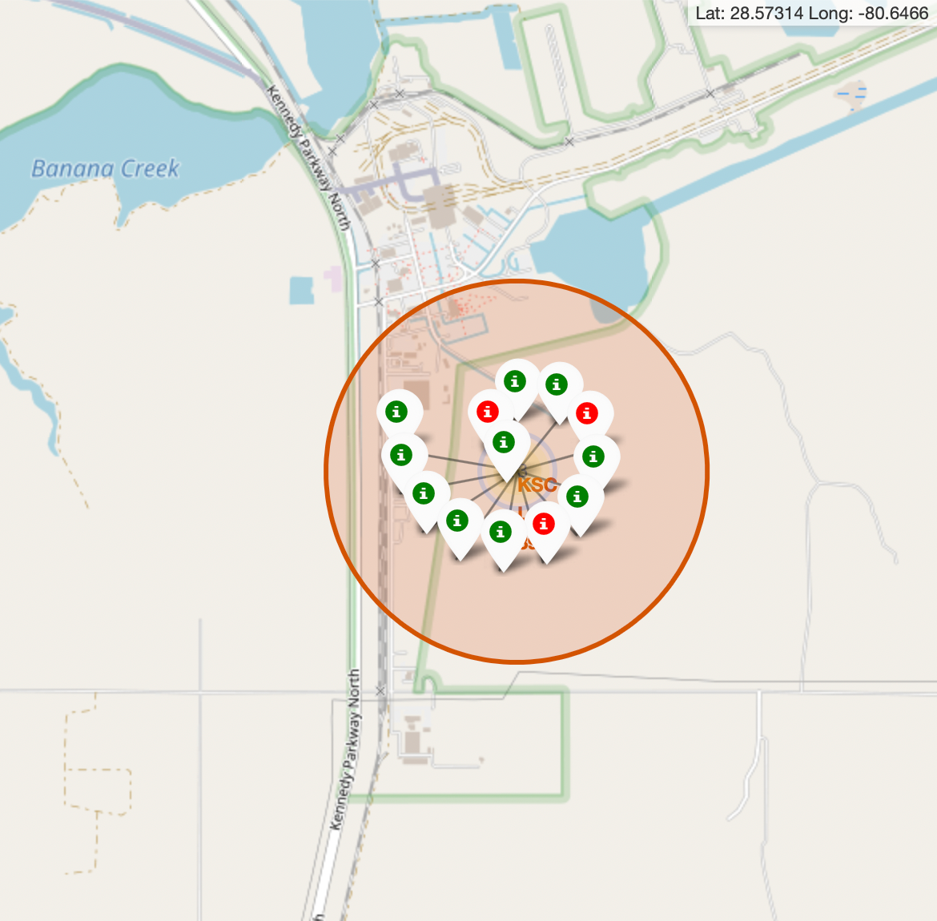
Colour-labeled launch records on the map
Explanation:
•From the colour-labeled markers
we should be able to easily identify which launch sites have relatively high success rates.
-Green Marker = Successful
Launch
-Red Marker = Failed Launch
•Launch Site KSC LC-39A has a
very high Success Rate.

Slide 38
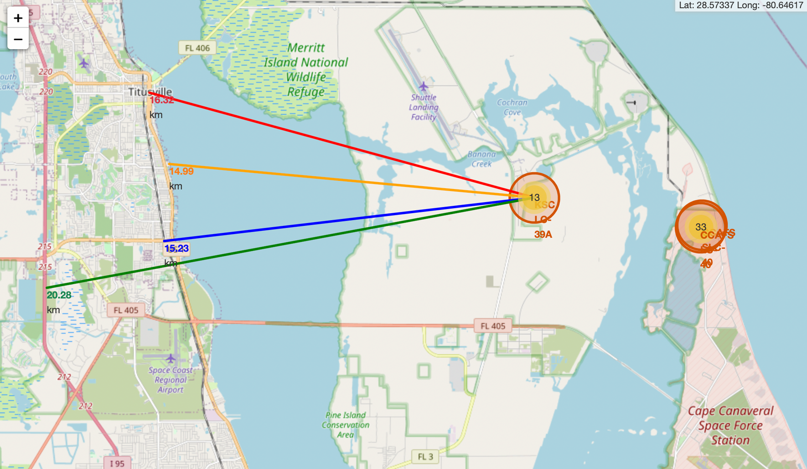
Distance from the launch site KSC LC-39A to its proximities
Explanation:
•From the visual analysis of the launch
site KSC LC-39A we can clearly see that it is:
-relative close to railway (15.23 km)
-relative close to highway (20.28 km)
-relative close to coastline (14.99 km)
•Also the launch site KSC LC-39A is
relative close to its closest city Titusville (16.32 km).
•Failed rocket with its high speed can
cover distances like 15-20 km in few
seconds. It could be potentially
dangerous to populated areas.

Slide 39
Build a Dashboard with Plotly Dash

Slide 40
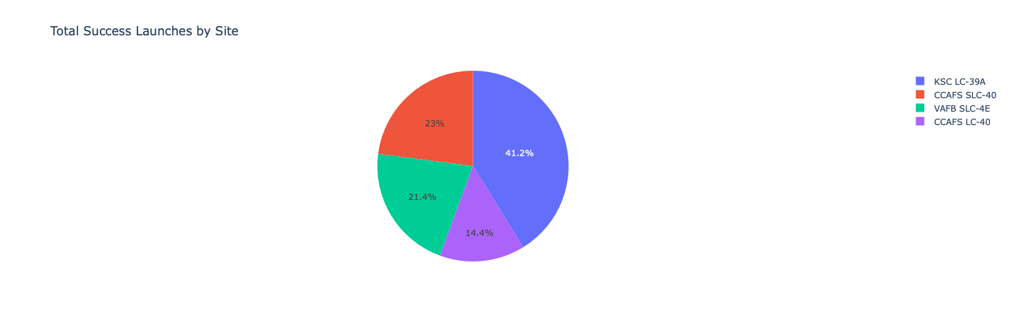
Launch success count for all sites
Explanation:
•The chart clearly shows that from all the sites, KSC LC-39A has the most
successful launches.

Slide 41
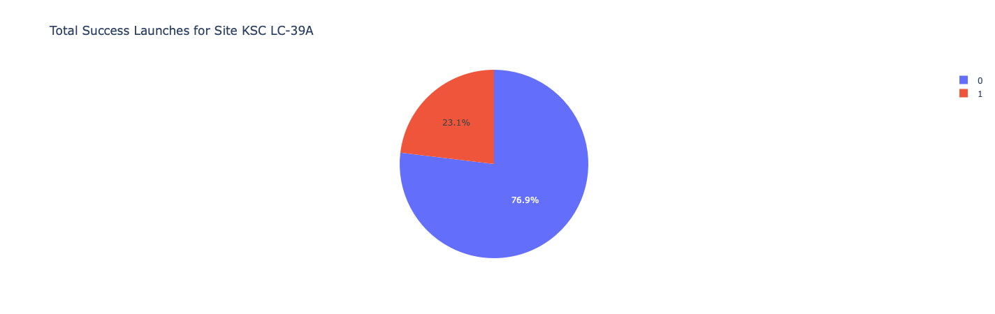
Highest launch success ratio
Explanation:
•KSC LC-39A has the highest launch success rate (76.9%) with 10 successful and
only 3 failed landings.

Slide 42
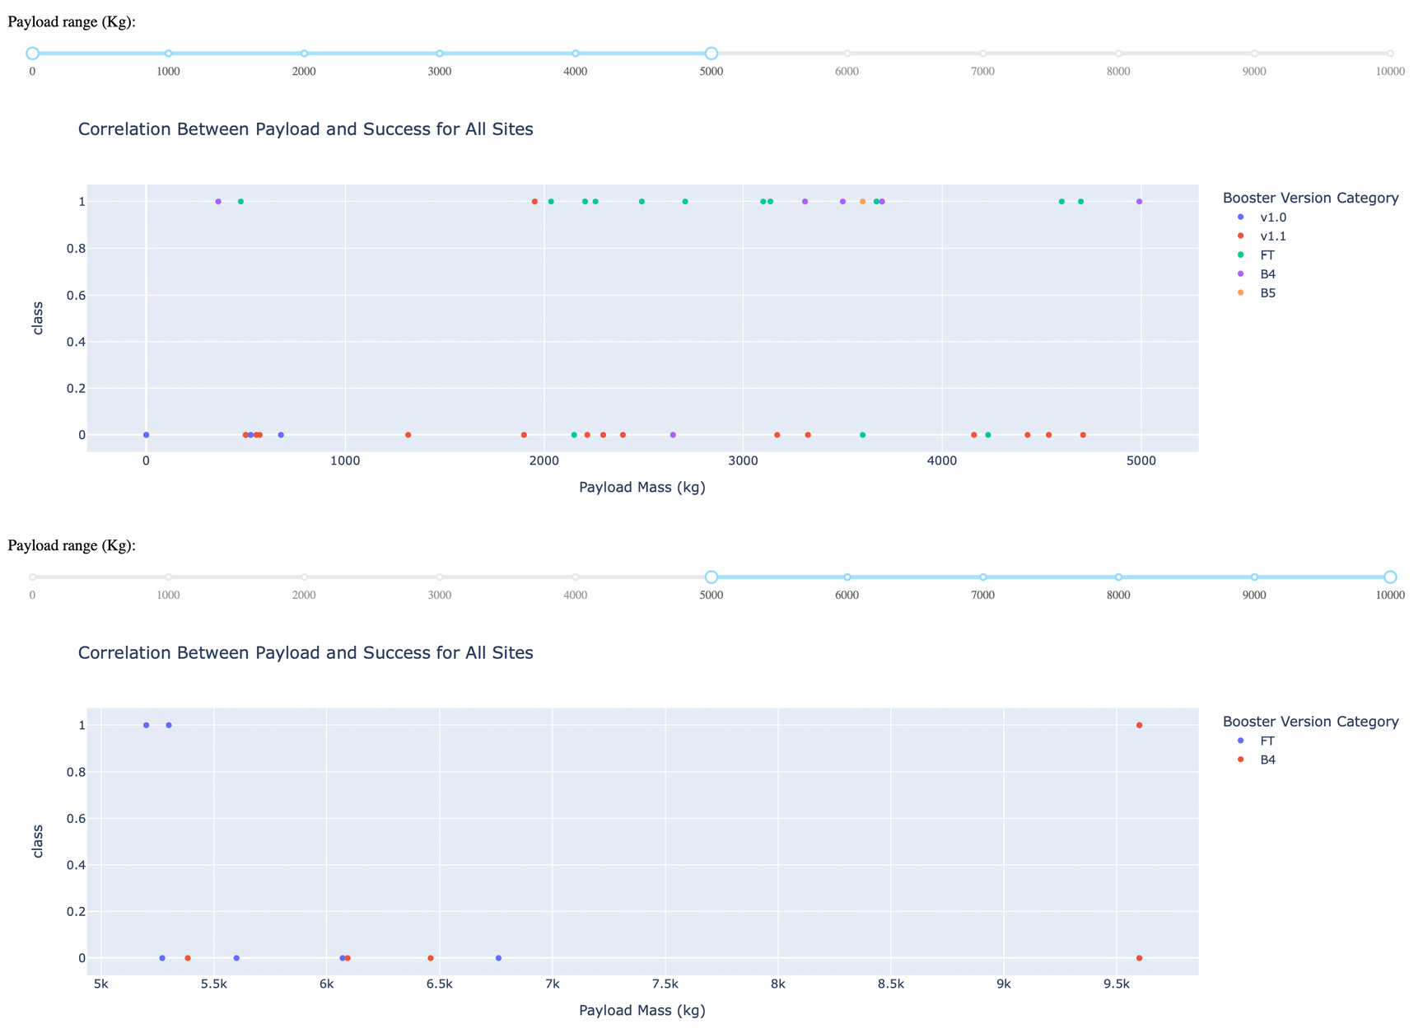
Payload Mass vs. Launch Outcome
Explanation:
•The charts show
that payloads between 2000 and 5500 kg have the highest success rate.

Slide 43
Predictive analysis (Classification)

Slide 44
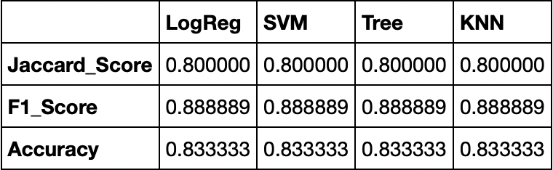
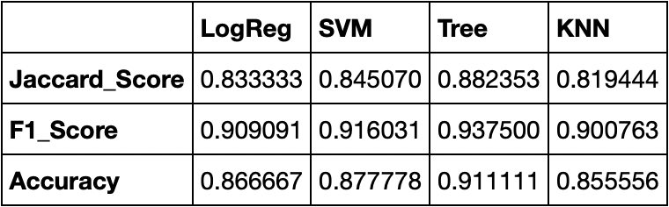
Classification Accuracy
Explanation:
Scores and Accuracy of the Test Set
•Based on the scores of the Test Set,
we can not confirm which method performs best.
•Same Test Set scores may be due
to the small test sample size (18
samples). Therefore, we tested all
methods based on the whole
Dataset.
Scores and Accuracy of the Entire Data Set
•The scores of the whole Dataset
confirm that the best model is the
Decision Tree Model. This model
has not only higher scores, but also
the highest accuracy.

Slide 45
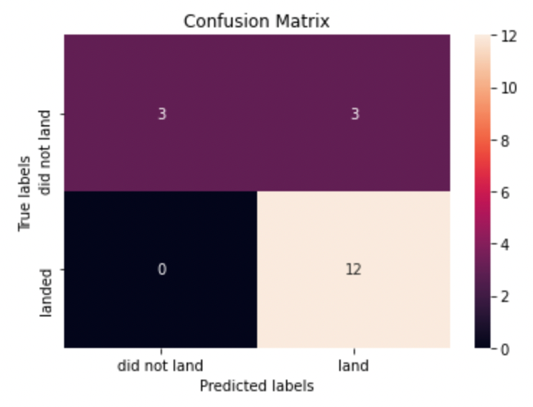
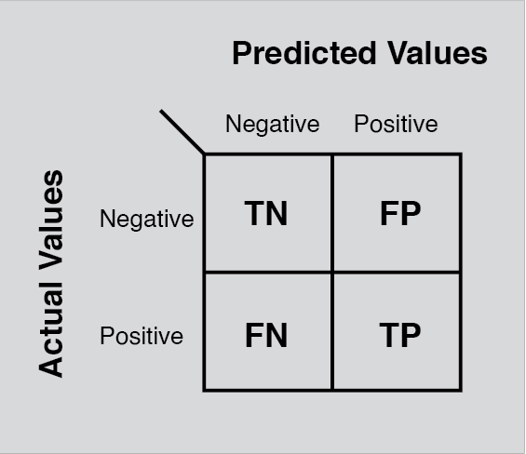
Confusion Matrix
Explanation:
•Examining the confusion matrix, we see
that logistic regression can distinguish between the different classes. We see that the major problem is false positives.

Slide 46
Conclusion
Decision Tree Model is the best algorithm for this dataset.
Launches with a low payload mass show better results than launches with a larger payload mass.
Most of launch sites are in proximity to the Equator line and all the sites are in very close proximity to the coast.
The success rate of launches increases over the years.
KSC LC-39A has the highest success rate of the launches from all the sites.
•Orbits ES-L1, GEO, HEO and SSO have 100% success rate.

